Slide 1
ROCKBUSTER STEALTH LLC
DATA ANALYSIS REPORT
MANDY YEUNG

Slide 2
P
Project Overview
Rockbuster Stealth LLC, once a prominet worldwide movie rental franchise, seeks to adjust to instense competition from streaming titans such as Netflix and Amazon by introducing an internet-based video rental platform.
G
Goals
Help with the launch strategry for the new internet-based video rental platform.

Slide 3
Strategic Objectives
Maximizing Revenue
Identify the top performing movies
Leveraging High-Value Customers
Improving Customer Experience
Recognize high lifetime value customers
Calculate the average rental duration to enhance customer satisfaction
Analyzing Geographic Performance
Expanding Market
Evaluate sales fluctuations across different regions to develop targeted growth strategies
Identify customer locations for targeted marketing

Slide 4
Top Performing Movies
Top earners are Telegraph Voyage and Zorro Ark
Adventure and drama are top genres

Slide 5
Sports and Sci-fi genres generate the highest revenue.
1
Comedy and documentary genres also make substantial contributions to revenue
2

Slide 6
Rockbuster Stealth at a glance
Replacement Cost
Films
Avg. $19.98
1,000
Movie Genre
Rental Duration
17
Average rental duration of all movies is 5 days
Customers
Rental Rate
599
Average rental rate for all movies are $2.98

Slide 7
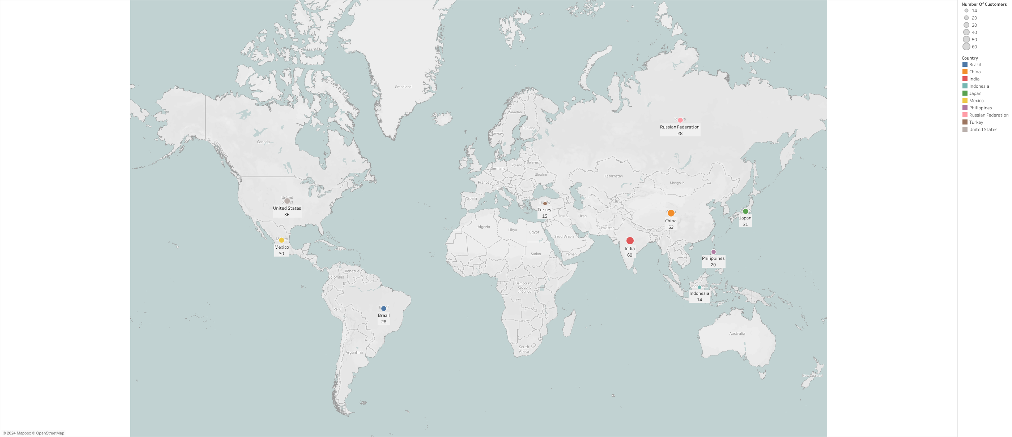
Top 10 countries with the highest customers count
India and China leads in customers and revenue
https://public.tableau.com/app/profile/mandy.yeung8359/viz/Rockbuster_CustomerCountByRegion/Sheet1?publish=yes

Slide 8
Top 10 Countries with highest revenue and customers
Revenue of $31,834 is generated from 315 customers, with the top 10 countries driving this income.
Country | Total Customers | Total Revenue ($)
India | 60 | 6,035
China | 53 | 5,251
United States | 36 | 3,685
Japan | 31 | 3,123
Mexico | 30 | 2,985
Brazil | 28 | 2,919
Russian Federation | 28 | 2,766
Philippines | 20 | 2,220
Turkey | 15 | 1,498
Indonesia | 14 | 1,353
India and China are the lead in customers and revenue.
A high number of customers aligns with revenue growth.

Slide 9
High-Value Customers
Customer Name | City | Country | Total Revenue Contributed ($)
Eleanor Hunt | Saint-Denis | Runion | 211.55
Karl Seal | Cape Coral | United States | 208.58
Marion Snyder | Santa Brbara dOeste | Brazil | 194.61
Rhonda Kennedy | Apeldoorn | Netherlands | 191.62
Clara Shaw | Molodetno | Belarus | 189.6
Tommy Collazo | Qomsheh | Iran | 183.63
Ana Bradley | Memphis | United States | 167.67
Curtis Irby | Richmond Hill | Canada | 167.62
Marcia Dean | Tanza | Philippines | 166.61
Mike Way | Valparai | India | 162.67
Eleanor Hunt leads with $211.55 revenue. Average of $184 per customer across 9 countries. Two high-value customers from USA

Slide 10
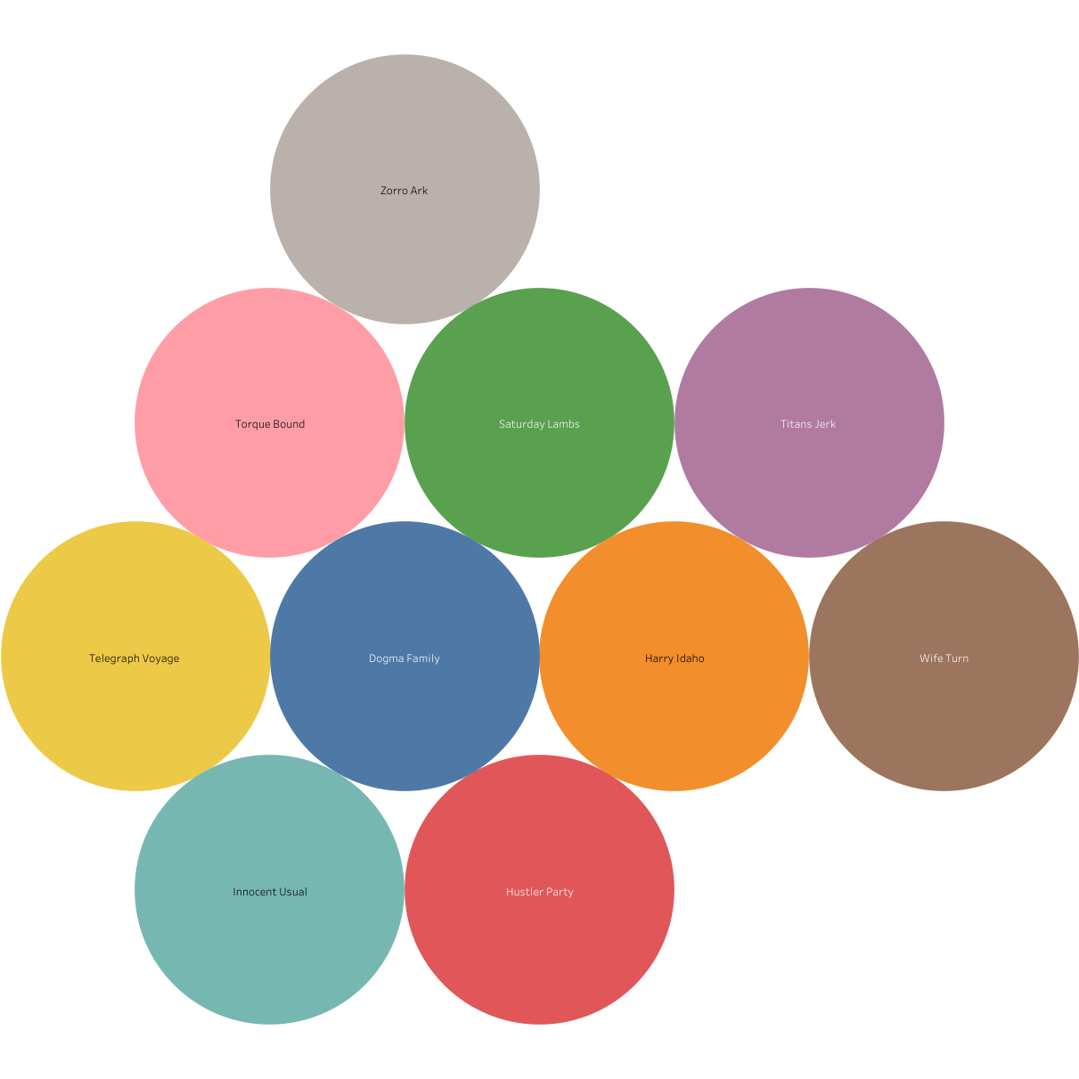
Top Movies | Top Genre
Telegraph Voyage | Sports
Zorro Ark | Sci-Fi
Wife Turn | Animation
Innocent Usual | Drama
Hustler Party | Comedy
Saturday Lambs | New
Titans Jerk | Action
Harry Idaho | Foreign
Torque Bound | Games
Dogma Family | Family
https://public.tableau.com/app/profile/mandy.yeung8359/viz/Rockbuster_TopMovies/Sheet2?publish=yes

Slide 11
Key Takeaway
Top-Revenue Movies: Telegraph Voyage & Zorro Ark. Adventure and Drama are favorites
1
Top Revenue Genres: Sports & Sci-Fi
2
Top Revenue Markets: India, China, USA – mark priority for target marketing and expansion
3
Eleanor Hunt and Karl Seal are top paying customers
4

Slide 12
Conclusion and Recommendations
Marketing Strategies:
Utilize genre-targeted marketing, with a particular emphasis on Sports and Sci-Fi, employing personalized promotions for customer retention.
Promote popular film categories and customer favorites.
Tailor content and marketing approaches for customers in key markets such as India, China, and the USA, to enhance engagement and foster loyalty.
Customer Engagement and Loyalty:
Implement loyalty programs to reward high-value customers, thereby boosting retention and lifetime value.
Use algorithms to deliver personalized recommendations.
Genre Focus:
Invest in expanding top genres while removing underperforming titles through regular updates of the movie catalogue, guided by customer preferences and market trends.
Pricing:
Introduce dynamic pricing based on file ratings and rental duration trends, with flexibility to accommodate customer preferences.

Slide 13
In-depth Research:
Conduct surveys and market analysis to understand customer’s viewing habits, preferences, and barriers to subscription.
Leverage insights gleaned from this research to refine the content acquisition strategy and enhance the user experience.
Analyze data on genre preferences and market trends to make informed decisions about acquiring content that aligns with customer interests, such as focusing on popular genres like Sports and Sci-Fi.
Consider customer feedback and engagement metrics to identify areas for improvement in the user experience, such as enhancing content discovery features or streamlining the rental process.
By incorporating these insights into the content acquisition strategy and user experience design, Rockbuster Stealth LLC can better meet the needs and preferences of the audience, ultimately driving increased satisfaction and loyalty.

Slide 14
ROCKBUSTER STEALTH LLC
THANK YOU
Questions or Feedback?
Mandy Yeung
Mandy.yeung@rockbuster.com

